Slide 1

Is it safe to eat mouldy jams?
Alexandra Malachová
Austrian Competence Centre for Feed and Food Quality, Safety and Innovation
University of Natural Resources and Life Science, IFA-Tulln
Forschungstag Obstbau, 26th January 2023

Slide 2
Moulds – where do they come from?
Moulds = microscopic fungi
are ubiquitous microorganism
are part of each ecosystem on the Earth
play important role in biodegradation
+
Biotechnology
Food industry (pigments, beverages, cheese…)
Pharmacology (antibiotics, various drugs enzymes)
-
Food spoilage
Property damage
Toxinogenic fungi – production of mycotoxins
Hazard to human and animal health

Slide 3
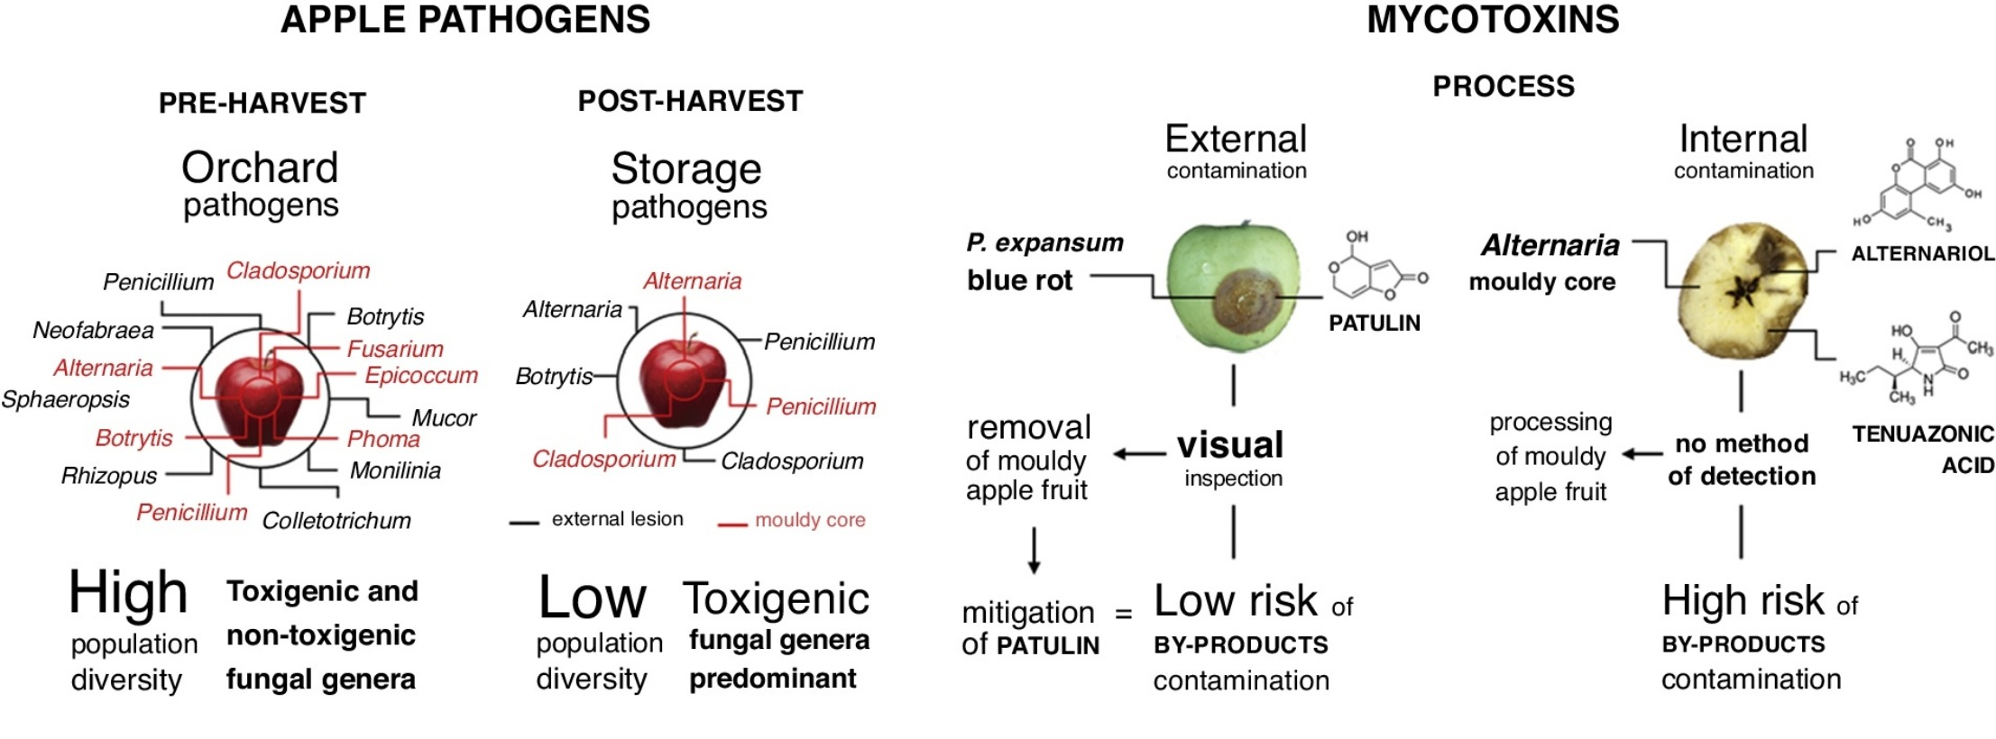
Patriarca, Curr. Opin. Food Sci, 2019, 29, 42

Slide 4
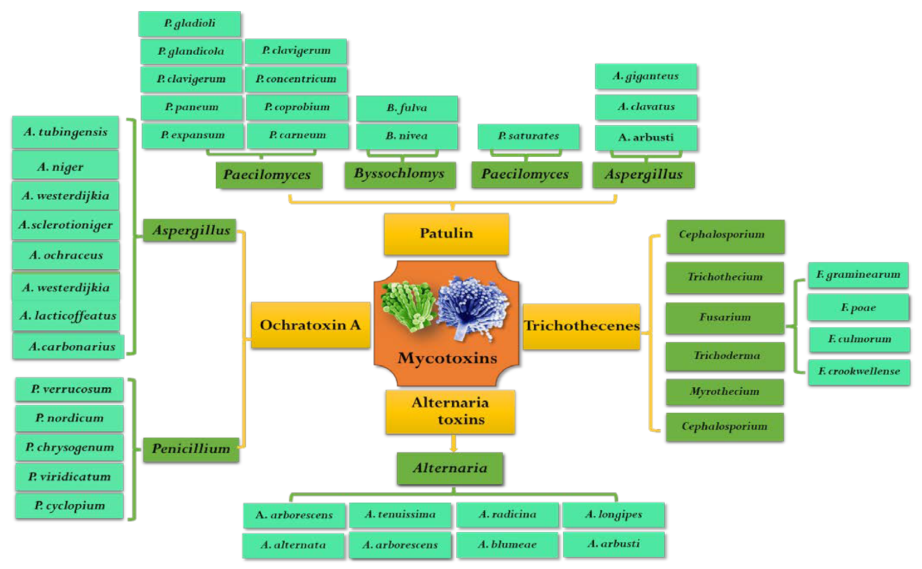
Toxinogenic fungi on fruit and vegetable
Nan at al., Toxins 2022, 14 (5), 309

Slide 5
Patriarca, Curr. Opin. Food Sci, 2019, 29, 42

Slide 6
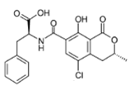


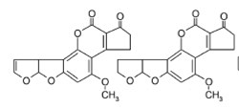

Mycotoxins in fruit
Regulation No 1881/2006 on maximum levels of certain contaminants in foodstuff
No regulation for fruit jams
patulin
ochratoxin A
Alternaria toxins
citrinin
aflatoxins

Slide 7




Food safety authorities recommendation on mouldy food
No official recommendation
Swedish Food Authority:
Discard mouldy food in general
Food Standard Agency UK:
Discard obviously mouldy and rotten food due to the health risk
The United State Department of Agriculture (USDA):
For jam and jelly: Discard

Slide 8
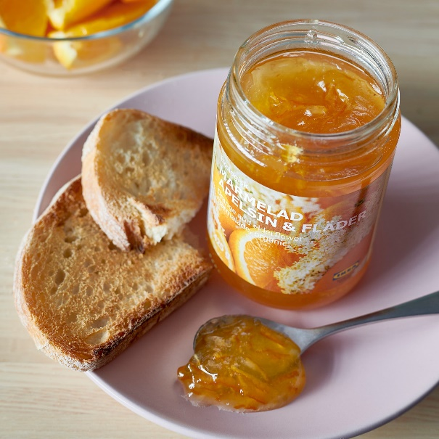
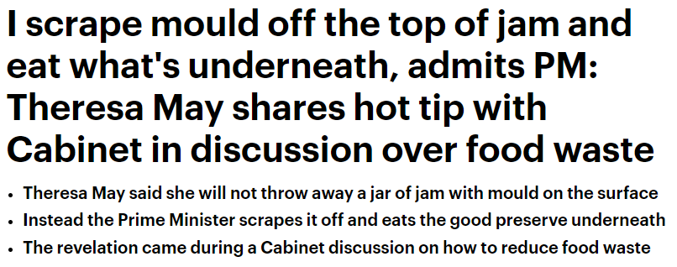

Mould expert Patrick Hickey for BBC documentary in 2014 advices
“If you scoop off all the mould and a few centimetres beneath to throw out difficult-to-see spores, the jam should be safe to eat”
Notes:
To me it was a controversion because all the food safety reccomendation are to toss the complete jar when the mold occure

Slide 9

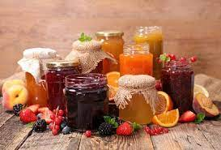
Jam samples description
75 mouldy samples collected from the austrian local producers
All samples originally closed
Preservative: citric acid, lemone juice, aronia juice, apple juice
6 groups based on the fruit type:
Fruit | No. of samples
Strawberries | 11
Raspberies | 10
Apricots | 17
Blueberries | 4
Blackberries | 4
Mixed | 29
Notes:
We were contacted by the Austrian Institute for viciculture and fruit growing in Klosterneuburg

Slide 10
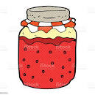
Goal of the study
Identification of fungi isolated from the jam surface
Determination of mycotoxins in mouldy jams
Investigation of the metabolomic profile of isolated fungi
Penetration of mycotoxins from the surface

Slide 11
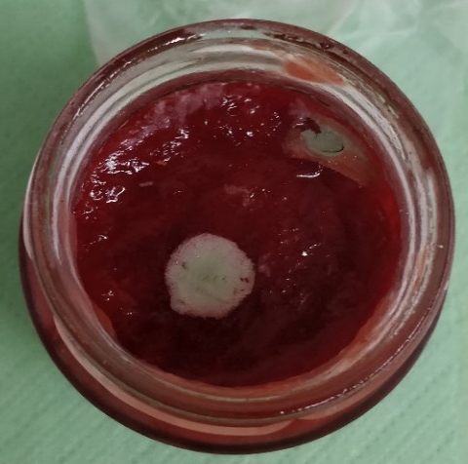
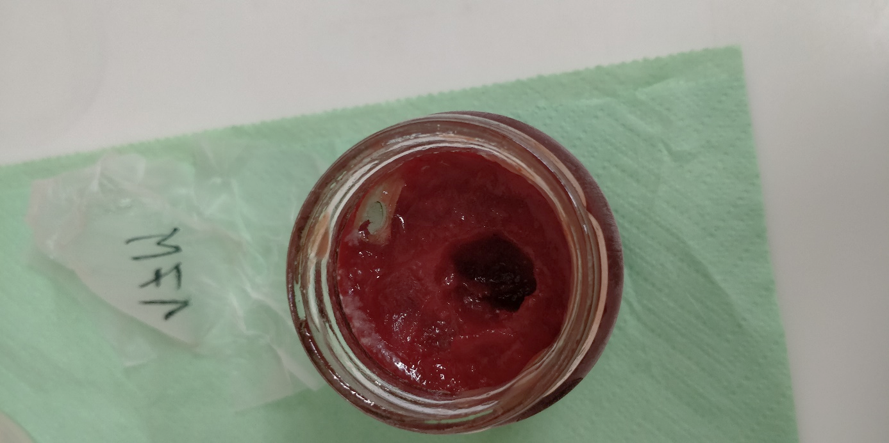
Mycotoxin determination
Sampling
Determination of mycotoxins in mouldy jams
3 sampling spots
Extraction
1:4 ratio
ACN/H₂O/HAc, (79/20/1,v/v/v)
Penetration of mycotoxins from the surface
Dilution 1:1
ACN/H₂O/HAc, (20/79/1,v/v/v)
LC-MS/MS

Slide 12
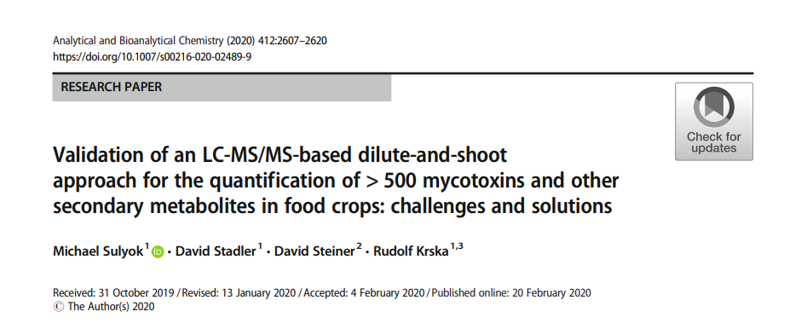
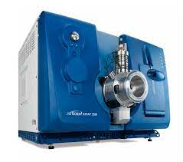
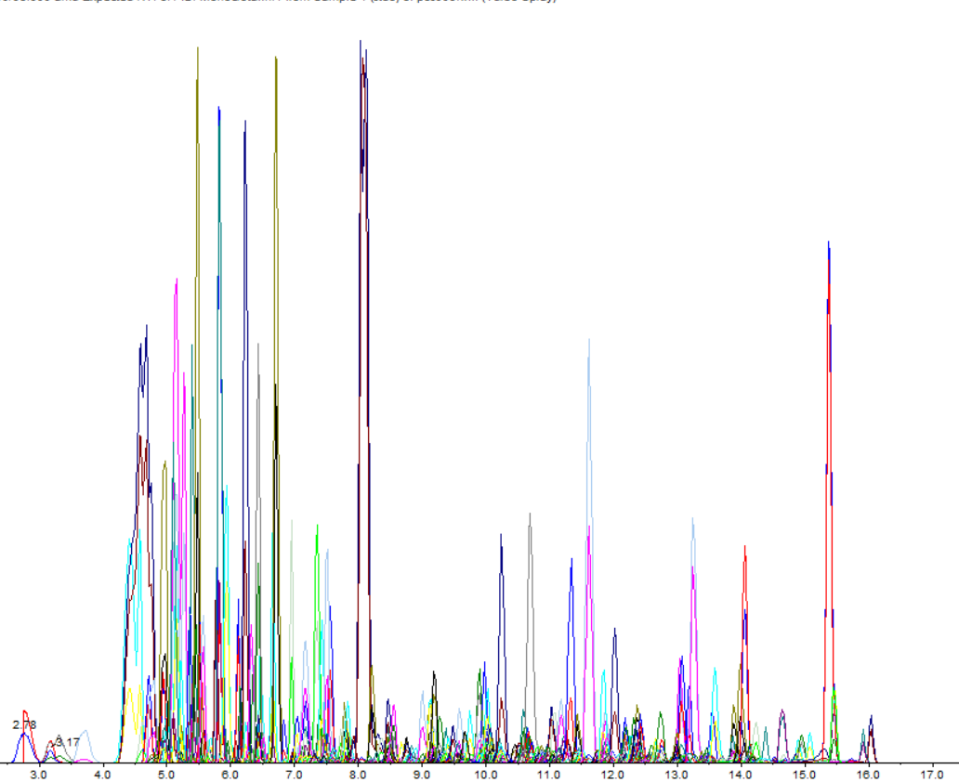
Liquid chromatography-tandem mass spectrometry
Agilent 1290 Infinity liquid chromatograph
Phenomenex Gemini HPLC column (C18, 150 x 4.6 mm, 5 µm)
Sciex Qtrap 5500, MRM scheduled mode, pos/neg ionization
> 1200 analytes in 40 min
Method accuracy evaluated on spiked matrix
Final results were corrected on apparent recovery

Slide 13
Fungal identification

Slide 14
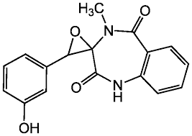
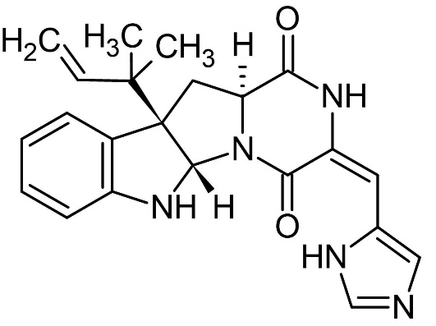
Penicillium crustosum-mycotoxin profile
Metabolite | Fungal extract | Jam
paspalin | ü | û
viridicatin | ü | ü
roquefortin C | ü | ü
penitrem A | ü | ü
viridicatol | ü | ü
cyclopenin | ü | ü
cyclopeptin | ü | ü
cyclopenol | ü | ü
dehydrocyclopeptin | ü | ü
cyclopenol
roquefortin C
Notes:
Interestingly, 3 jams out of 15 did not contain any detectable level of mycotoxins produces by P. crustosum

Slide 15
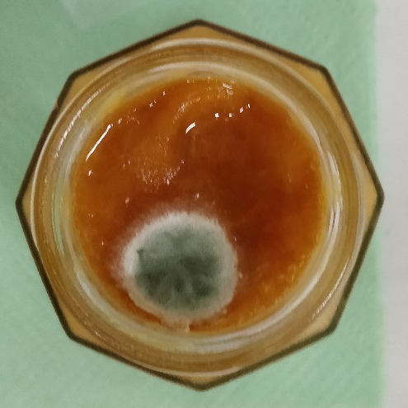
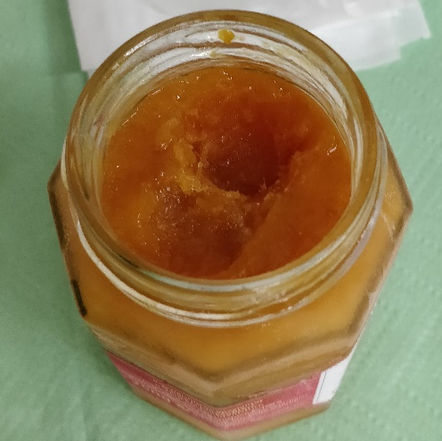
Penicillium crustosum metabolites distribution
Apricot jam
Fruit content (%): 70
Sugar content (%): 41
Pectin: yes
Preservative: lemon juice
High mycotoxin levels!
Analyte | Mycelium (µg/kg) | 1 cm below mycelium spot (µg/kg) | Surface 1 cm from mycelium spot (µg/kg)
cyclopenol | 6,000 | 461 | 126
cyclopenin | 313 | 196 | 5
cyclopeptin | 266 | 29 | 10
roquefortin C | 1,226 | 39 | 3
penitrem A | 52 | n.d. | n.d.
viridicatin | 655 | 18 | 18
viridicatol | 1,567 | 22 | 49
Notes:
Interestingly, 3 jams out of 15 did not contain any detectable level of mycotoxins produces by P. crustosum

Slide 16
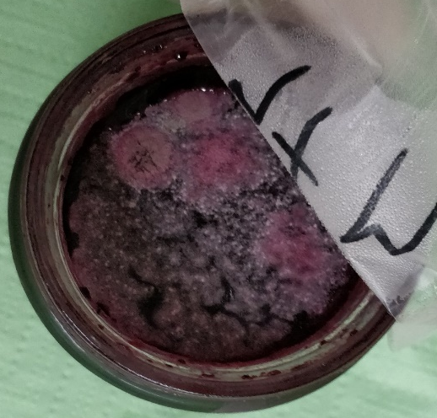
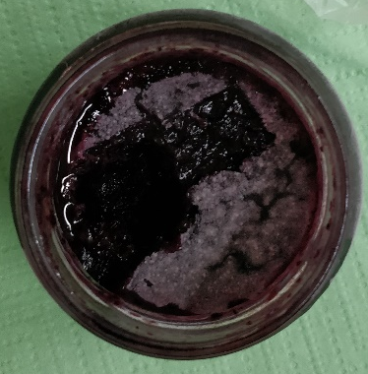
Penicillium crustosum metabolites distribution
Mixed fruit jam
Fruit content (%): unknown
Sugar content (%): unknown
Pectin: unknown
Preservative: unknown
Analyte | Mycelium (µg/kg) | 1 cm below mycelium spot (µg/kg) | Surface 1 cm from mycelium spot (µg/kg)
cyclopenol | 21 | 6 | 4
cyclopenin | 1 | 0.2 | n.d.
cyclopeptin | 4 | 0.9 | 0.3
roquefortin C | 125 | 3 | 19
penitrem A | 6 | n.d. | 2
viridicatin | 25 | 4 | 2
viridicatol | 52 | 11 | n.d.
Notes:
Interestingly, 3 jams out of 15 did not contain any detectable level of mycotoxins produces by P. crustosum

Slide 17
Aspergillus versicolor – metabolite profile
Metabolite | Fungal extract | Jam
aurasperon C | ü | û
averantin | ü | û
averufin | ü | û
sterigmatocystin | ü | û
tryprostatin B | ü | ü
violaceol I | ü | ü
violaceol II | ü | ü
versicolorin A | ü | ü
versicolorin C | ü | ü
violaceol I
sterigmatosytin

Slide 18
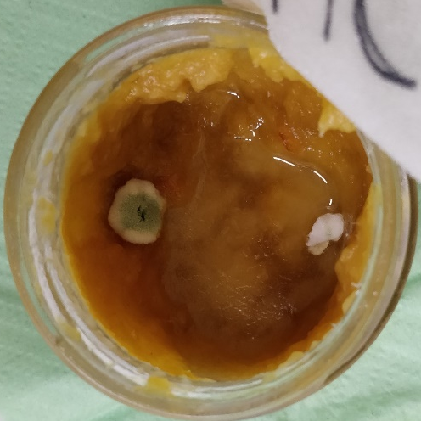
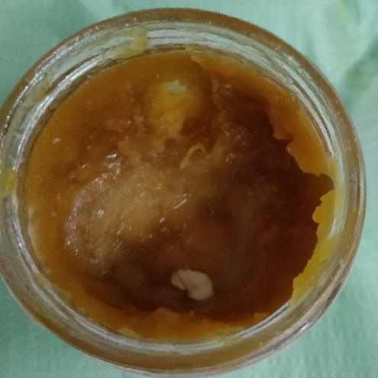
Apergillus versicolor metabolite distribution
Orange-ginger jam
Fruit content (%): 70
Sugar content (%): 42
Pectin: yes
Preservative: citric acid
Analyte | Mycelium (µg/kg) | 1 cm below mycelium spot (µg/kg) | Surface 1 cm from mycelium spot (µg/kg)
violaceol I | 15,000 | 2,123 | 1,546
violaceol II | 248 | 13 | 8
Notes:
Interestingly, 3 jams out of 15 did not contain any detectable level of mycotoxins produces by P. crustosum

Slide 19
Conclusion
P. crustosum, P. brevicompactum, A. versicolor – highest incidence
Fungi metabolic profile matched the mycotoxin patter in jams
Highest levels of mycotoxins found in the mycelium spot
Jam surface and deeper layers => 10x – 25x lower than in the mycelium spot
Scrape the mold off the jam or toss the jar?
Scrape the visible mycelium and a few centimeters beneath reduces significantly food safety risk
Figure 3. Jam sample before sampling Figure 4. Jam sample after sampling

Slide 20

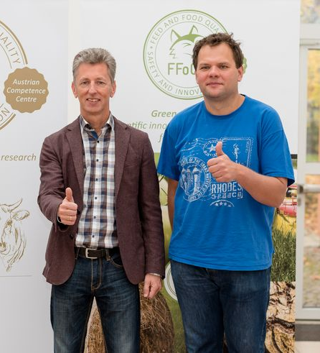


Aknowledgement
Manfred Gössinger
Melita Krpan
Roman Labuda
Rudolf Krska and Michael Sulyok
Figure 3. Jam sample before sampling Figure 4. Jam sample after sampling

Slide 21
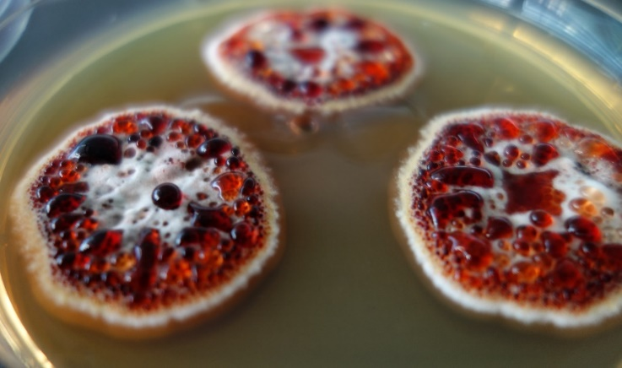
Thank you for your attention! alexandra.malachova@ffoqsi.at
Penicillium krskae
By courtesy of Roman Labuda, BiMM

